Slide 1


ENGLISH LEVEL B1 - II
Lesson 02
SHOPPING
Notes:
Teacher’s Notes:
Explain the lesson goal: learning words and sentences related to hospitals.
Ask students: Have you ever been to a hospital? Why?

Slide 2

01
Learn to talk about buying clothes
02
Use phrasal verbs when speaking
ENGLISH LEVEL B1 - II

Slide 3
01
01
Learn to talk about buying clothes

Slide 4
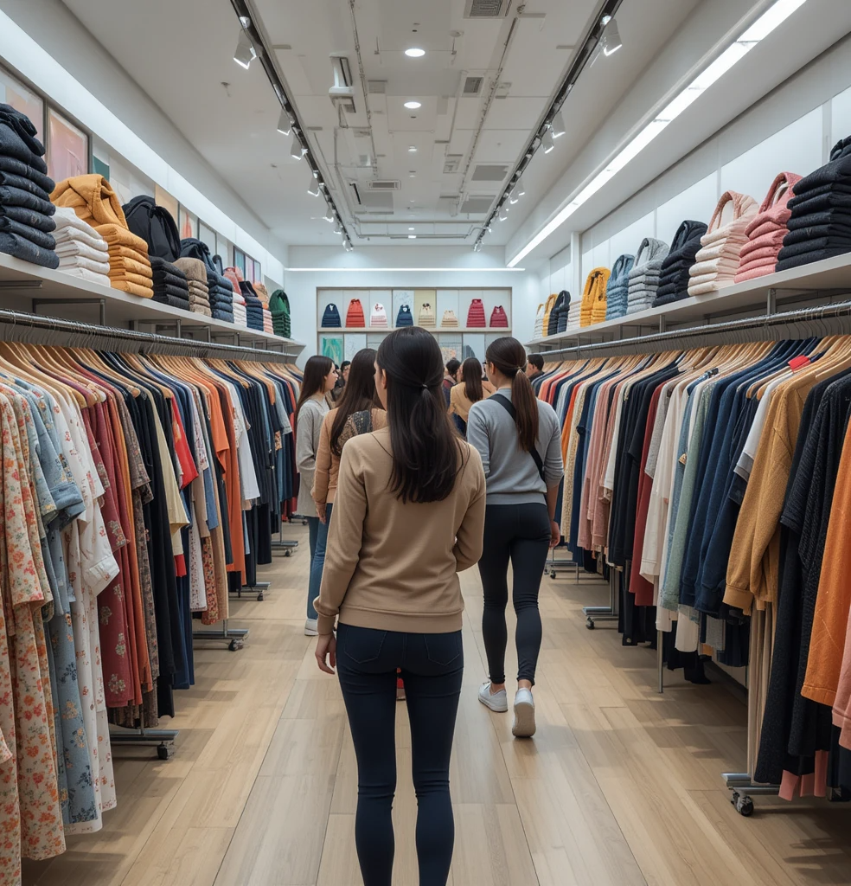
LEARN TO TALK ABOUT BUYING CLOTHES
SHOPPING CONTEXT
Look at the picture about “Shopping” and answer the questions below.
1
What do you see in the picture?
2
Do you like to buy clothes?
3
What are your favorite clothes?
4
Do you prefer shopping online or in a store? Why?
Notes:
Teacher notes:
Ask students to look at the image and comment on what they see in it.
Kindly correct them if necessary.

Slide 5


LEARN TO TALK ABOUT BUYING CLOTHES
Listen to the conversation about shopping clothes and answer the questions below:
Why does Emma think the skirt might not be the right size?
What item of clothing does Emma want to try on near the accessories aisle?
Why does Paul think Emma should buy the blouse despite the price?
What does Emma decide to buy along with her new clothes?
INSERTAR DIÁLOGO ALTISSIA

Slide 6
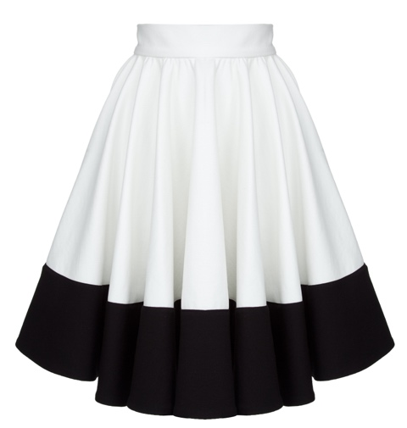
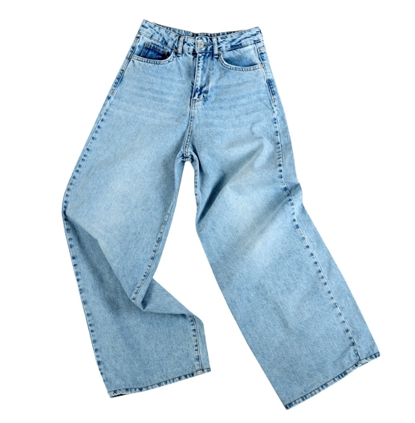
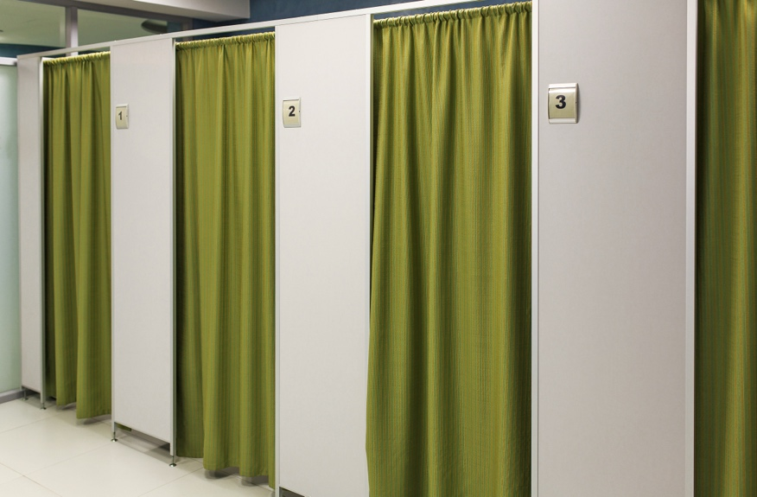
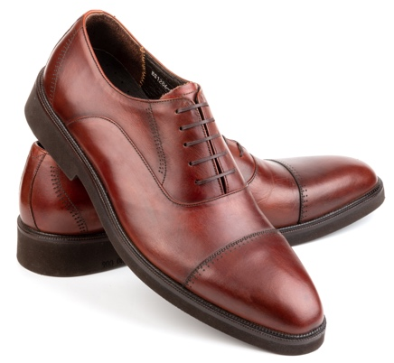
LEARN TO TALK ABOUT BUYING CLOTHES
Find the correct word for each picture and then make a sentence using each one:
______________________________
______________________________
______________________________
______________________________

Slide 7
LEARN TO TALK ABOUT BUYING CLOTHES
KEY VOCABULARY WORDS:
Vocabulary:
Activity:
Clothes: skirt, trousers (pants), shoes, blouse, shirt, jacket, dress.
Shopping terms: dressing room, size, price, brand, sale, discount, checkout.
Verbs: try on, buy, pay for, look for, fit, suit.
Fill-in-the-Blanks:
I want to __try on____ this dress before I buy it.
These ______ don’t ______ me. They are too tight!
The cashier said the total ______ is $25.
This coat ______ you! It looks great.
Where is the ______? I want to try on this shirt.
This store is having a big ______ today!
I need to ______ a new pair of black shoes for work.
She always ______ her clothes with a credit card.

Slide 8
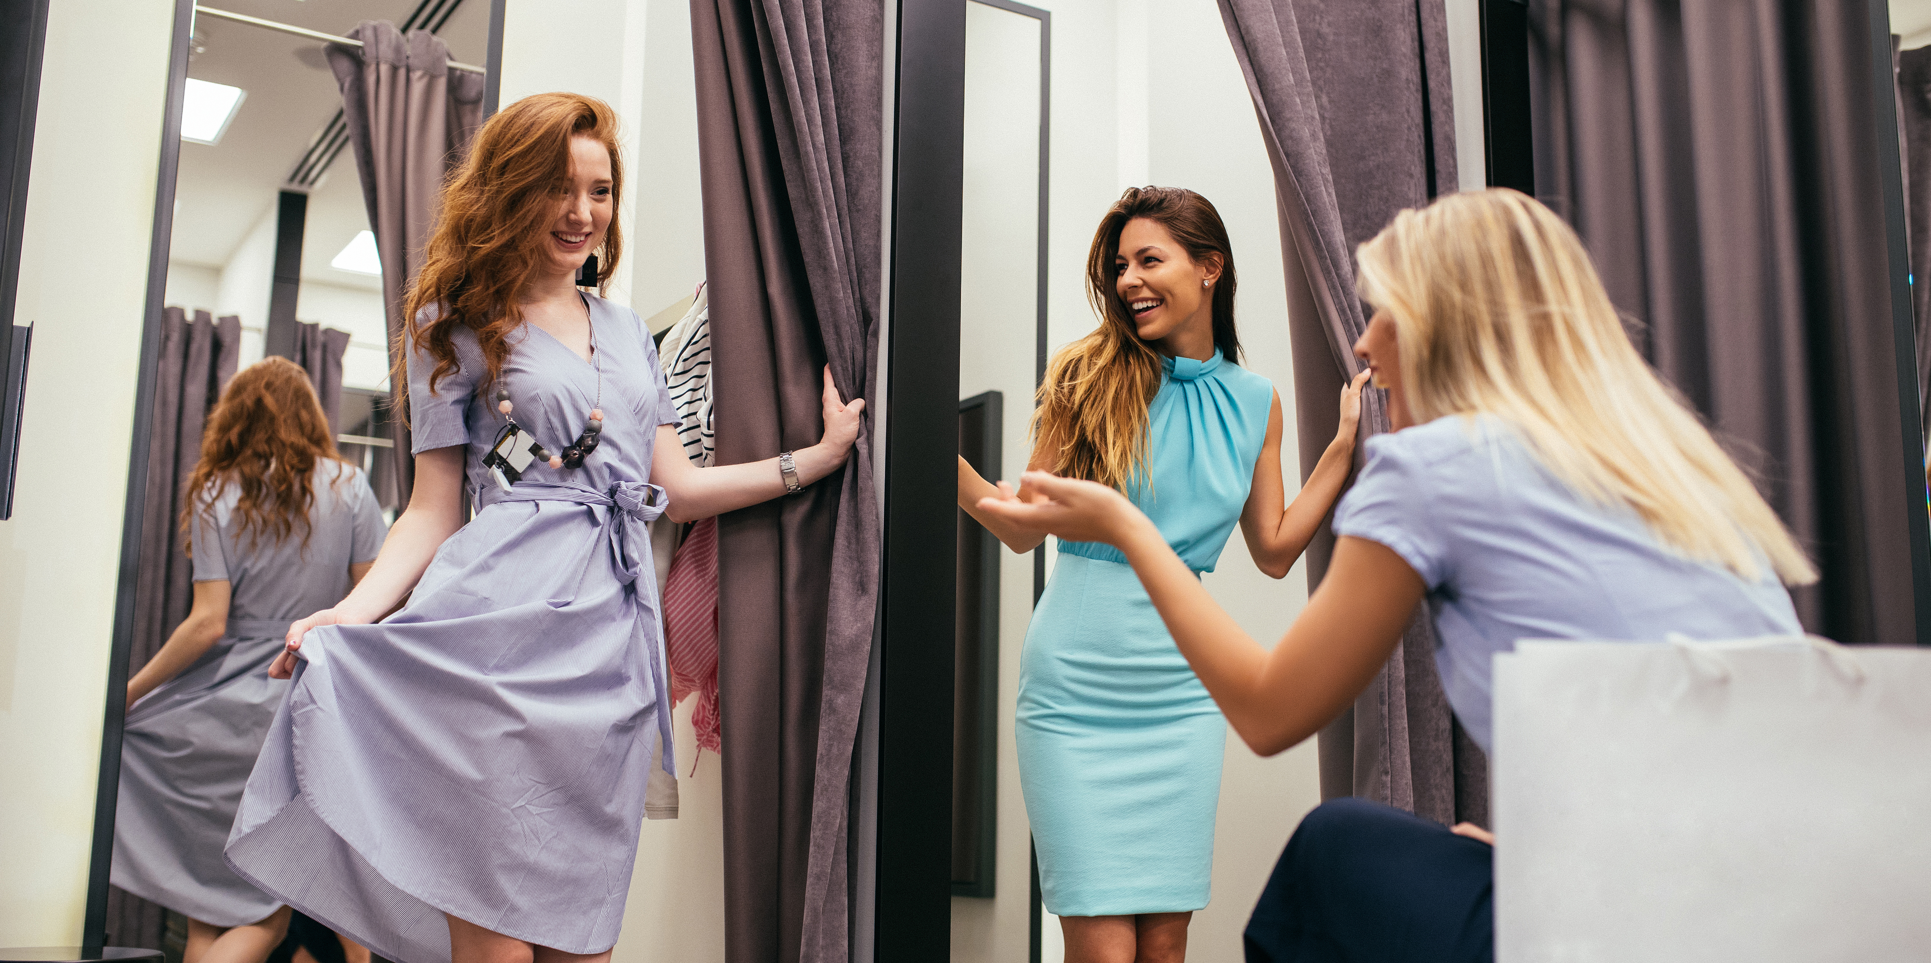
LEARN TO TALK ABOUT BUYING CLOTHES
Useful Sentences:
Mini Role-Play:
"Excuse me, where can I find a size 38?"
"I want to try on this dress."
"This jacket fits me well, but the color doesn’t suit me."
"Do you have this in a different color?"
"Is this on sale?"
"I will pay with cash/card.“
One student is the customer; the other is the shop assistant.
Practice asking and answering questions while shopping.
Example:
Customer: Excuse me, do you have this dress in a smaller size?
Shop Assistant: Let me check. What size do you need?
Customer: I think a size 38 would fit me better. Also, do you have this in a different color?
Shop Assistant: Yes, we have it in red and blue.
Customer: Great! I will try the blue one.

Slide 9
01
02
Use phrasal verbs when speaking

Slide 10
PHRASAL VERBS - VOCABULARY
USE PHRASAL VERBS WHEN SPEAKING
Common Phrasal Verbs:
Activity:
Set off (start a trip) – "We set off early in the morning.“
Pick up (collect someone) – "I will pick you up at the hotel.“
Drop off (take someone somewhere) – "He dropped me off at the airport.“
Try on (test clothes) – "I tried on a jacket at the store.“
Break down (car stops working) – "Our car broke down on the highway.“
Stop off (take a break during a trip) – "We stopped off at a small café."
Complete the Sentences with the Correct Phrasal Verb:
We will ______ at 6 a.m. so we can arrive early.
My car ______ on the way to the store, so I had to call for help.
Can you ______ me ______ at the mall? I don’t want to take the bus.
I need to ______ this jacket before I buy it.
We always ______ at a small restaurant during road trips.
I will ______ you ______ at the hotel at 8 p.m.

Slide 11
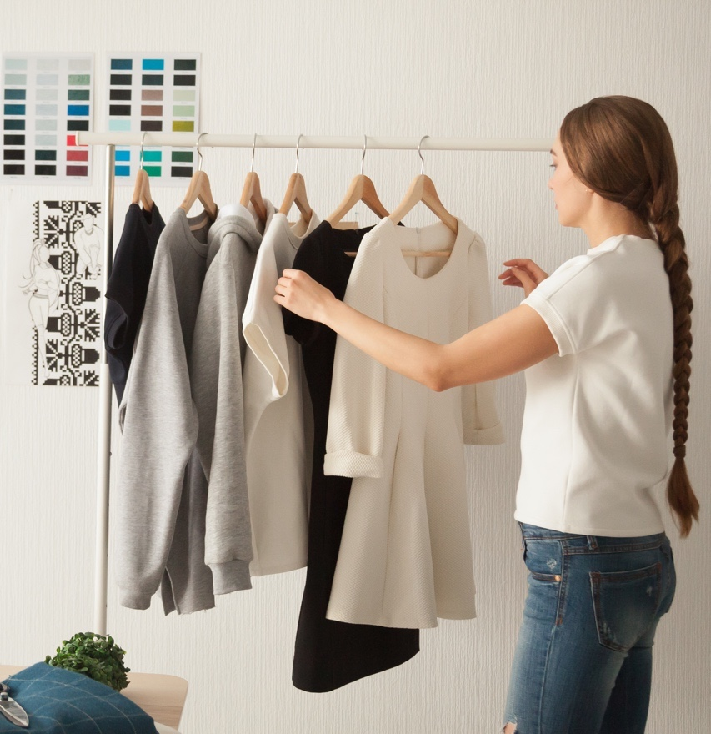

USE PHRASAL VERBS WHEN SPEAKING
CLASS DISCUSSION: REFLECT AND APPLY
What did you learn today?
Which new words or phrases were useful?
What does "try on" mean?
If your clothes don’t "fit," what is the problem?
What should you say if you want a different size?
What phrasal verb means "start a trip"?
If a car "breaks down," what happened?

